Slide 1

7COM1079-20204 Student Group No: a_group183 Names of Student Attendees: Lakshmi Priya Pattem
Sai Rohith Kotaru,
Balaji Jada,
Eswar Redyy Amudam,
Sai Kumar Medeipelli.
Group Name: A_group183 Name of Student Presenting: Lakshmi Priya Pattem
Research Question : “Is there a correlation between number of Suicides and Age of 18-95 ?

Slide 2
2
7COM1079-2024 Student Group No: a_group183 Names of Student Group Attendees: Lakshmi Priya Pattem
Sai Rohith Kotaru,
Balaji Jada,
Eswar Redyy Amudam,
Sai Kumar Medeipelli.
Dataset URL: https://data.world/makeovermonday/2019w43 and DS244
Our Independent variable is: Age This Independent variable datatype is : Ordinal Our Dependent variable is: Suicide This Dependent variable datatype is : Interval
Notes:
Before specifying your Research Question you must define the type of data you are analysing. Are the variables you select interval data (measurement data you can divide, multiple, etc), OR are they ordinal (there is a definite order but the intervals between each variable are not necessarily equal, or the terms might be subjective like in a likert scale); OR are they just categorical/nominal (Items such as film names, cities, etc., that you can count numbers of occurrences? You also need to understand whether the variable is either dependent or independent and this will vary according to the context. Independent variables may cause an effect, whereas the dependent variable might be effected by the independent variable. Check the lecture notes on the RQ for more information and examples.
You will get only one opportunity to present your Research Question ahead of the submission date. Have your questions ready, and be ready to take notes on feedback.
2

Slide 3
7COM1079-2024 Student Group No: a_group183
3
Our Research Question is
“Is there a correlation between number of Suicides and Age of 18-95 ?
1. Null hypothesis (H_{o}): There is no difference between number of Suicides and Age of 18-95 2. Alternative hypothesis (H₁); There is a difference between number of Suicides and Age of 18-95
Notes:
3

Slide 4
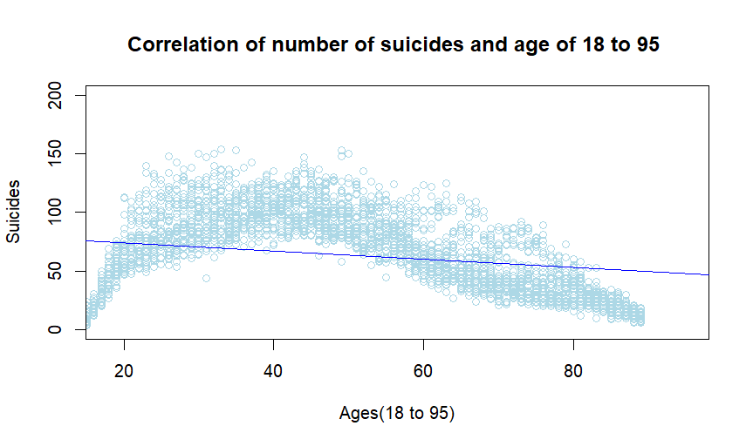
Visualization:

Slide 5
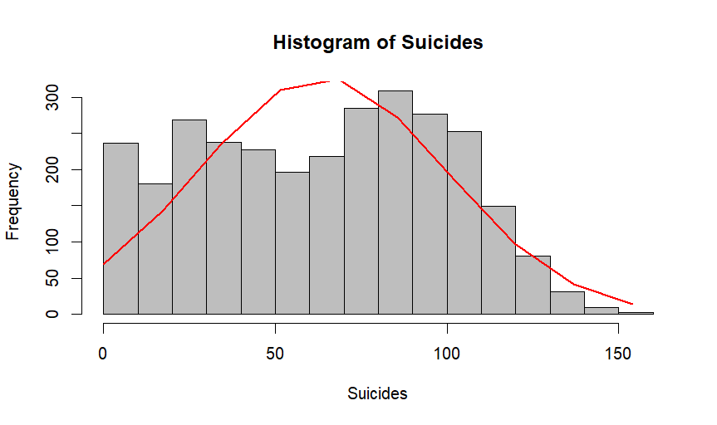
Histogram:

Slide 6
